Slide 1
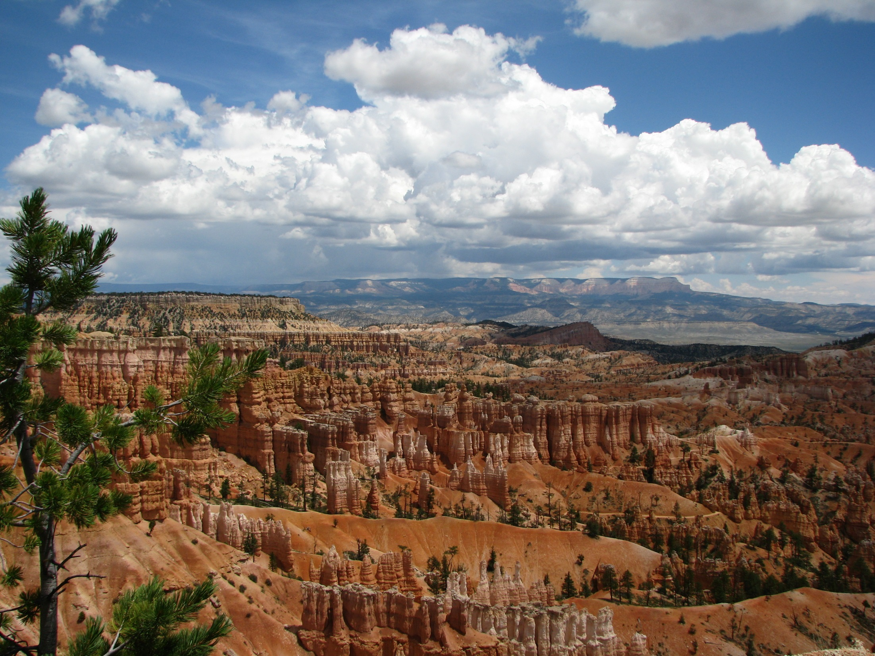
Utah’s Air Quality
Bryce Bird
Department of Environmental Quality
Division of Air Quality
bbird@utah.gov
801-536-4000

Slide 2
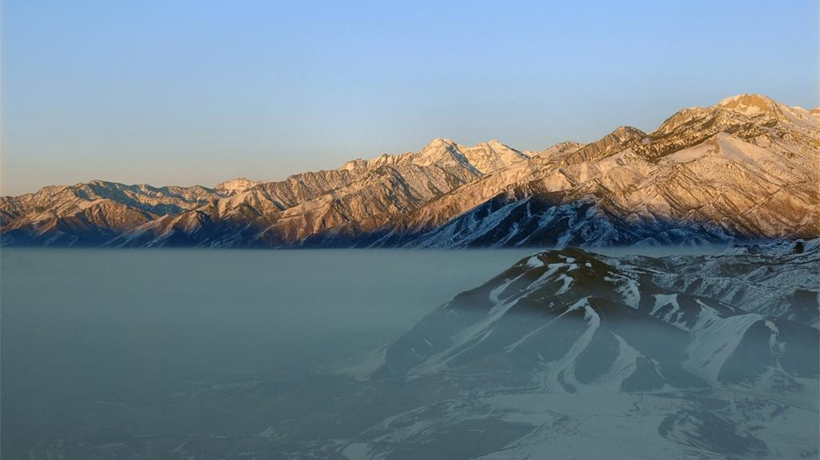
Utah experiences good air quality, except for about 5% of days on average when we exceed current federal health standards

Slide 3
Air Quality
Transport
Growth
Policy
Emissions
Chemistry/
Meteorology/
Topography
Population
Exposure/
Impairment
Available Controls

Slide 4
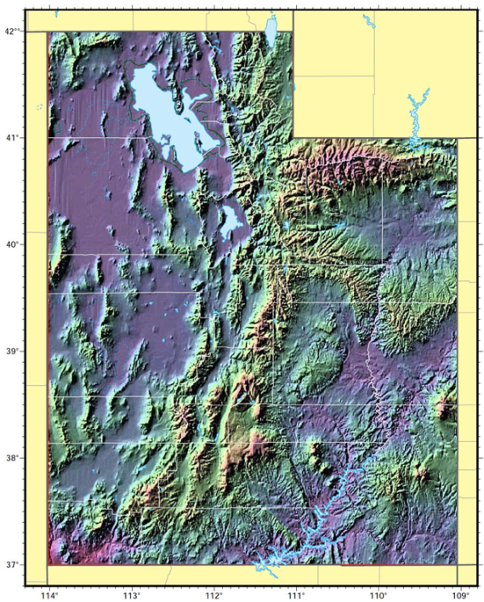
Land Ownership and Topography

Slide 5
Results in Concentrated Population and Associated Pollution
Urbanites: Nine of 10 Utahns live on 1 percent of state’s land
Census » Utah is among most urban states in nation.
By Lee Davidson The Salt Lake Tribune
First Published Mar 26 2012 04:14 pm • Last Updated Mar 27 2012 11:42 am
Nine of every 10 Utahns now live in urban areas — and crowd together onto just 1.1 percent of the state’s land mass, according to 2010 Census data released Monday.
That makes Utah the eighth most-urbanized state in the nation. It is more urban than such states as New York, Illinois and Connecticut.
http://www.sltrib.com/sltrib/politics/53794385-90/areas-census-concentration-front.html.csp

Slide 6
Non-attainment and Maintenance Areas

Slide 7
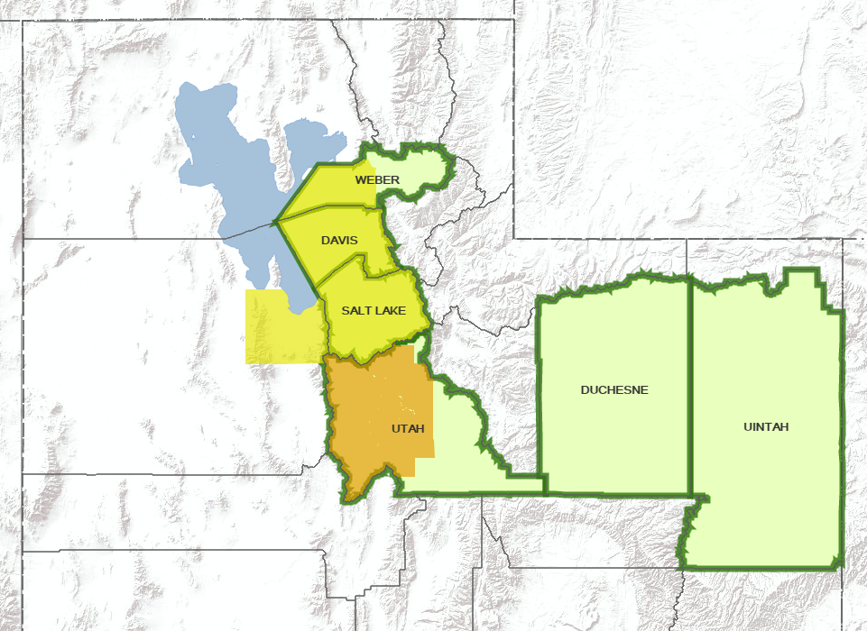
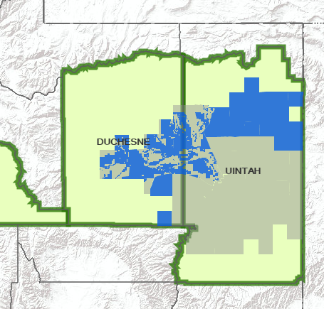
Staff Review of Area Recommendations for the 2015 Ozone Standard

Slide 8
Number of Days That Are and Those That Would Have Been Above the Current Federal Standards Salt Lake, Cache, and Utah County Areas
* Days with monitored values above the level of the current National Ambient Air Quality Standards combined for PM2.5 and ozone (PM2.5 standard revised in 2006, ozone standard revised in 2015) + pending final quality assurance

Slide 9
Wasatch Front Counties: Utah, Salt Lake, Davis and Weber
Average Winter Day
NO_{x}, VOC, SO₂ and Direct PM_{2.5} (most important contributors)
2002 2008 2014
Tons/Day
471 386 320
Source: Utah Division of Air Quality

Slide 10
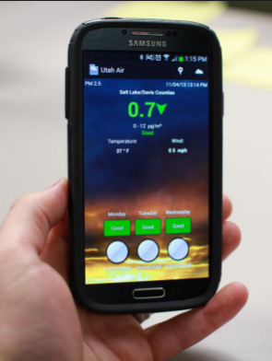
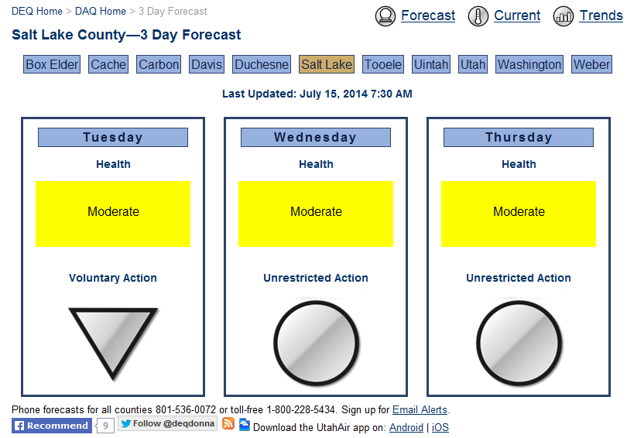
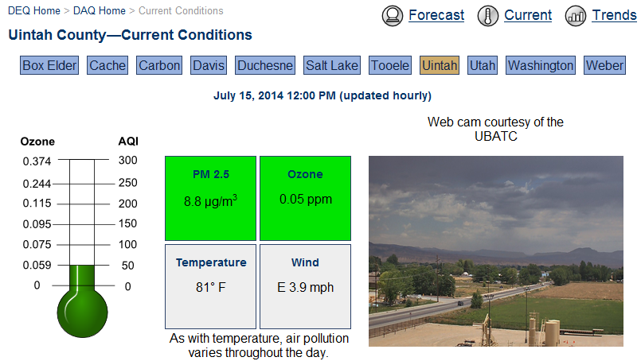
Three Day Forecast and App
Notify the Public of:
Forecast Air Quality Conditions to allow the Public to Plan Activities
Public Health Advisories
Air Pollution Alert and Action Days

